Slide 3
Entrepreneurship & Education – The Interest is Growing

Slide 5
WHY
ENTREPRENEURIAL
EDUCATION?

Slide 12
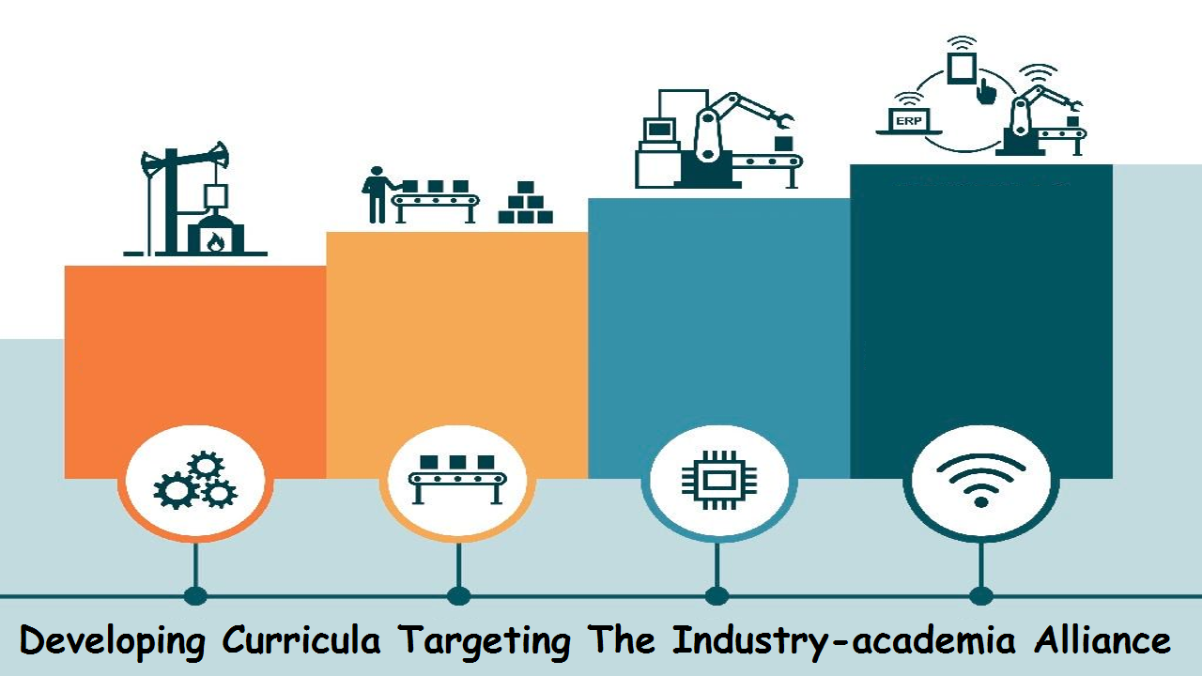

Slide 31
To Create Entrepreneurs
Encouraging students towards entrepreneurship
Department of Entrepreneurship
Industry-Academia Lecture Series
Entrepreneurship and Innovation Expo 2013

Slide 34
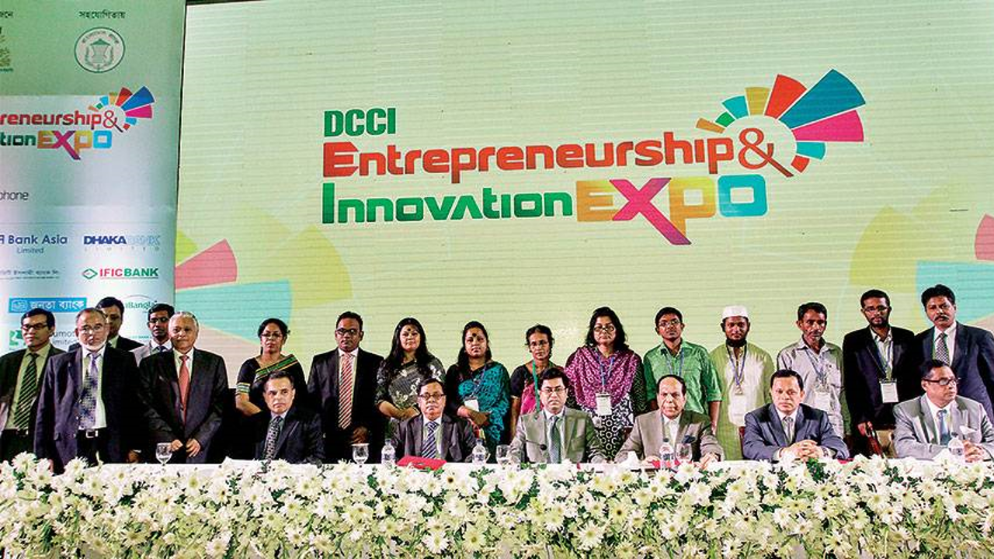

Slide 38
Affiliation

Slide 39
To Create Entrepreneurs
Encouraging students towards entrepreneurship
Global Young Entrepreneurs’ Summit 2015
Global Entrepreneurship Summer Camp 2016 Malaysia
Social Business Creation-2016

Slide 40
To Create Entrepreneurs
Encouraging students towards entrepreneurship
Start Your Business (SYB), ILO
Training Program for Women Entrepreneurs
Startup Fest 2016

Slide 41
Get in The Ring, National Final 2015

