Slide 1
Development Strategy of Educational Institution which has International Competitive towards Sustainable Development of ASEAN Region
Dr. Md. Sabur Khan
Chairman
Daffodil International University &
Daffodil Family

Slide 2
The paper strives to find out…
Strategies to ensure the sustainable development of higher education institutions in ASEAN Region.
Strategic alliance among universities
Challenges to ensure sustainable development of higher education
Recommendations for sustainable development of higher education

Slide 3
Introduction
The ASEAN Socio-Cultural Community (ASCC) is one of the three pillars of ASEAN Community. Education lies at the core of ASEAN’s development process, creating a knowledge-based society and contributing to the enhancement of ASEAN competitiveness. At the 11th Summit in December 2005, ASEAN Leaders set new directions for regional education collaboration when they welcomed the decision of the ASEAN Education Ministers to convene the ASEAN Education Ministers’ Meetings (ASED) on a regular basis. The ASEAN Education Ministers identified four priorities that ASEAN cooperation on education would address, namely: (i) Promoting ASEAN Awareness among ASEAN citizens, particularly youth; (ii) Strengthening ASEAN identity through education; (iii) Building ASEAN human resources in the field of education; and (iv) Strengthening ASEAN University Networking. To this end, various projects and activities have been/are being developed/organized to fulfil the directives. The ASEAN University Network (AUN) was established to serve as an ASEAN mechanism to (i) Promote cooperation among ASEAN scholars, academicians, and scientists in the region; (ii) Develop academic and professional human resource in the region; (iii) Promote information dissemination among the ASEAN academic community; and, (iv) Enhance the awareness of regional identity and the sense of ‘ASEANness’ among members.

Slide 4
Sustainable Development Goals (Sdgs) of The Un
Goal # 4: Ensure inclusive and quality education for all and promote lifelong learning
Obtaining a quality education is the foundation to improving people’s lives and sustainable development. Basic literacy skills have improved tremendously, yet bolder efforts are needed to make even greater strides for achieving universal education goals. For example, the world has achieved equality in primary education between girls and boys, but few countries have achieved that target at all levels of education.

Slide 5
Sustainable Development of Higher Education Institutions

Slide 6
Sustainable Development of Higher Education Institutions
Adoption of Research and Innovation
Effective Teaching and Learning
Sustainable Education
Knowledge Sharing
Vocational and Technical Education

Slide 7
Areas of Emphasis for Ensuring Sustainability
1
Real need-based Academic knowledge sharing
2
Ensuring Research collaboration
3
Industry-academia alliance
4
Employability (self-employment)
5
Eco-friendly Campus Operation with modern amenities
6
Public Service

Slide 8
PRIME CHALLENGES
Disciplinary organizational structure hindering integrative thinking and interdisciplinary cooperation and learning
SD is perceived as an “add -on”, not a built-in aspect of higher education
Lack of vision and prioritization /leadership of SD among higher education leaders
Lack of awareness, common understanding and knowledge of sustainability in higher education and its consequences
Lack of coordination and vision to change sustainability policies and education at government level
Lack of (financial) resources and uncertainty about the required efforts/resources to engage and implement sustainability
Strategic combined movements are required

Slide 9
Prospective Strategies
Exchange programs, both academic and cultural (for both teachers and students) with other universities of the region, at first, and then rest of the world
Encouraging teachers and students towards extensive research on SDGs, specially related to higher education and employment
Practice Innovative Teaching-Learning and Utilizing Technology in Education
Promoting and ensuring skills-based (both IT and others) higher education as well as secondary education
Exploring the opportunities by HEIs to highlight SDGs in various platforms
Adopting and replicating the best quality practices by various higher education institutions of the globe to ensure quality in everywhere in the institution
Curriculum upgradation and development of other resources to teach the SDGs to students
The Higher Education Sustainability Initiative (HESI), through its strong association with the United Nations, may like to provide HEIs with a unique interface between higher education, science, and policy making.
Shaping the curricula, as per requirement of the industry and future employment market and as per predicted future research requirements based on advanced technological development
Research collaboration with foreign and local universities to connect with the research environment on other universities

Slide 10
Strategies (Cont’d)
Putting more emphasis on industry-academia alliance (specially for research collaboration)
The United Nations may like to extend collaboration with higher education institutions of countries where quality of higher education is not up to the international standard through its UN Programs.
Working seriously for fruitful internationalization of the HEIs
Publication of sustainability report regularly to stakeholders for receiving feedback for further improvement and modification of mechanism.
Vision and Mission and strategic plan of the HEI should be modified based on the significance of sustainable development to be internationally competitive and implement the same
There is a need to include sustainable development criteria in pedagogical quality assurance mechanism.
Measurable and demonstrable assessment mechanism and indicators to monitor the progress of sustainability initiatives of HEIs.

Slide 11
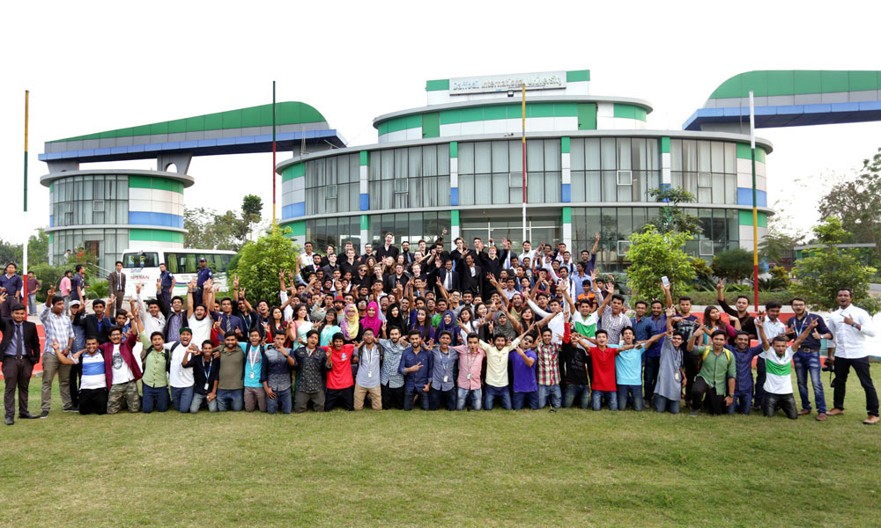
Initiatives from Daffodil International University
‘Are You the Next Startup?’ | Academic journal publication
Daffodil Startup Market | Yunus Social Business Centre
DIU Social Business Design Lab | Get in the Ring (GITR) Bangladesh
innovation hub | Entrepreneur Guidance Program (EGP)
Bangladesh Venture Capital Ltd. | Entrepreneurs Meetup
Innovation & Incubation Centre (IIC) | Enterprise Competitiveness Institute
Industry-Academia Lecture Series | Daffodil Business Incubator (DBI)
Global Entrepreneurship Summer Program | Kauffman FastTrack
Global Youth Entrepreneurship Summit | Frequent industry visit
Global Entrepreneurs Week | Real project work
Book Publications on entrepreneurship | Entrepreneurship & Innovation Expo

Slide 12
Conclusions
To emphasize the role of sustainable and competitive higher education as a catalyst of sustainable development of a country as well as the regional development, ASEAN member countries should take the initiative to integrate other developing countries, vigorously. They should also focus the development of other developing countries of South Asia as regional integration, now, becomes an important driver in global economies.

Slide 13
THANK YOU!
Questions?

