Slide 1


BUILDING
ONE GLOBAL
ECOSYSTEM
#GEC18IST
#GEC18IST | ISTANBUL, TURKEY | APRIL 16 – 19, 2018

Slide 2
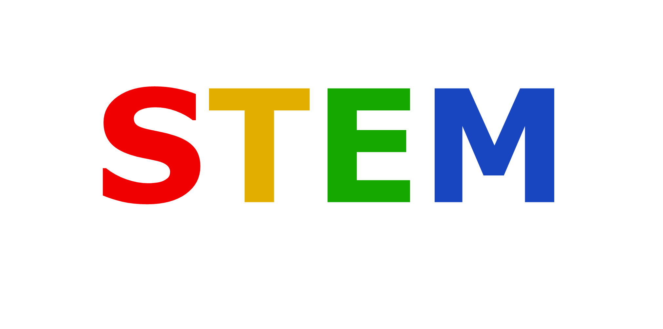
The Future of Work
Dr. Md. Sabur Khan
Chairman, BoT
Daffodil International University
#GEC18IST | ISTANBUL, TURKEY | APRIL 16 – 19, 2018

Slide 3


The future of work is going to look very different, as
AUTOMATION
and
ARTIFICIAL INTELLIGENCE
make many manual, repetitive jobs obsolete.

Slide 4

According to the McKinsey Global Institute, robots could replace 800 million jobs by 2030, while the World Economic Forum suggests a “SKILLS REVOLUTION” could open up a raft of new opportunities.

Slide 5

Why STEM

Slide 6



Collaboration
Creativity

Slide 7
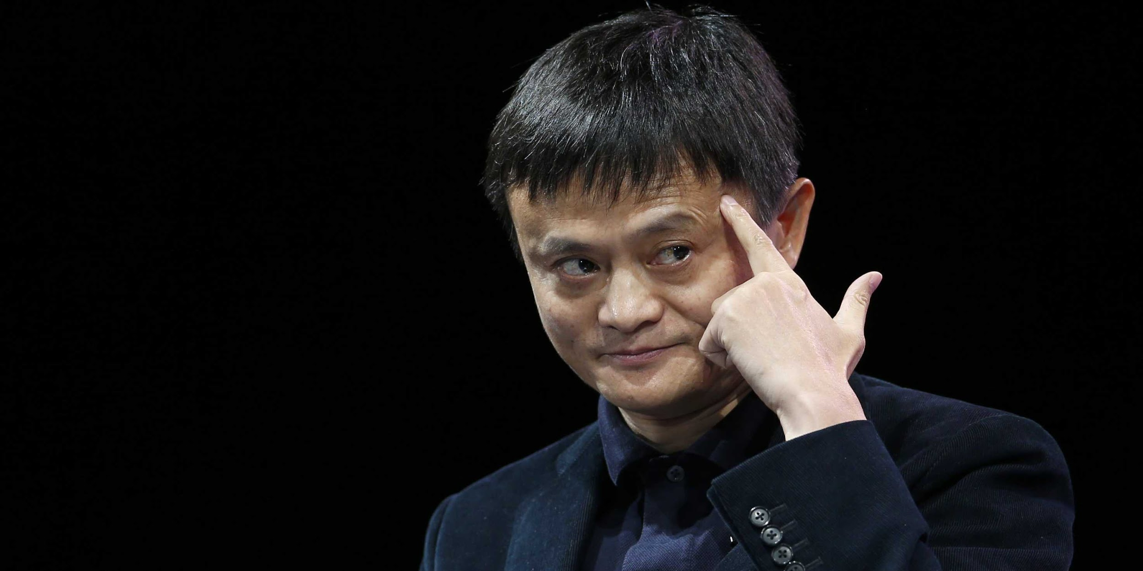
“If we do not change the way we teach, 30 years from now, we’re going to be in trouble”
Jack Ma,
founder, Alibaba Group

Slide 8


4th
Industrial Revolution

Slide 9




Importance of STEM Education
For striving towards innovation and development
For Rigorous and Sustainable Development
For real-world applications
For enhancing Critical Thinking abilities

Slide 10
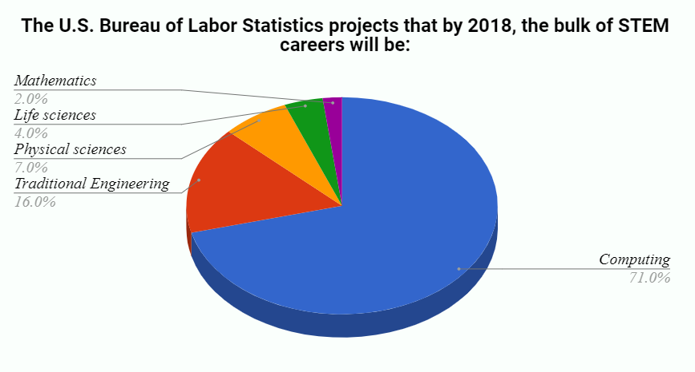
Global Projection

Slide 11

Prospective Jobs in Future
WORLD ECONOMIC FORUM
predicted the following 8 jobs every company will be hiring for by 2020:
Data analysts
Senior managers
Computer and mathematical jobs
Architects and engineering jobs
Product designers
Specialized sales people
Regulatory and government relations experts
HR and organizational development specialists

Slide 12
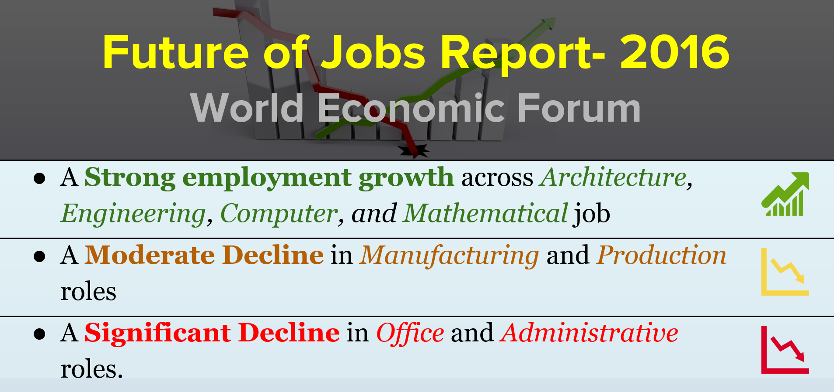

Slide 13
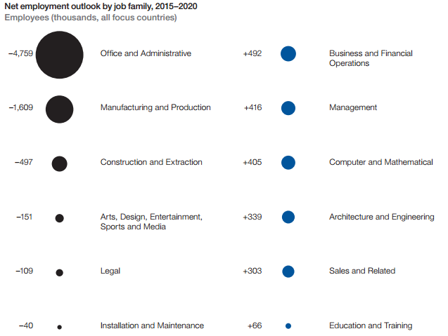

Growth
of
STEM
Job
Market

Slide 14
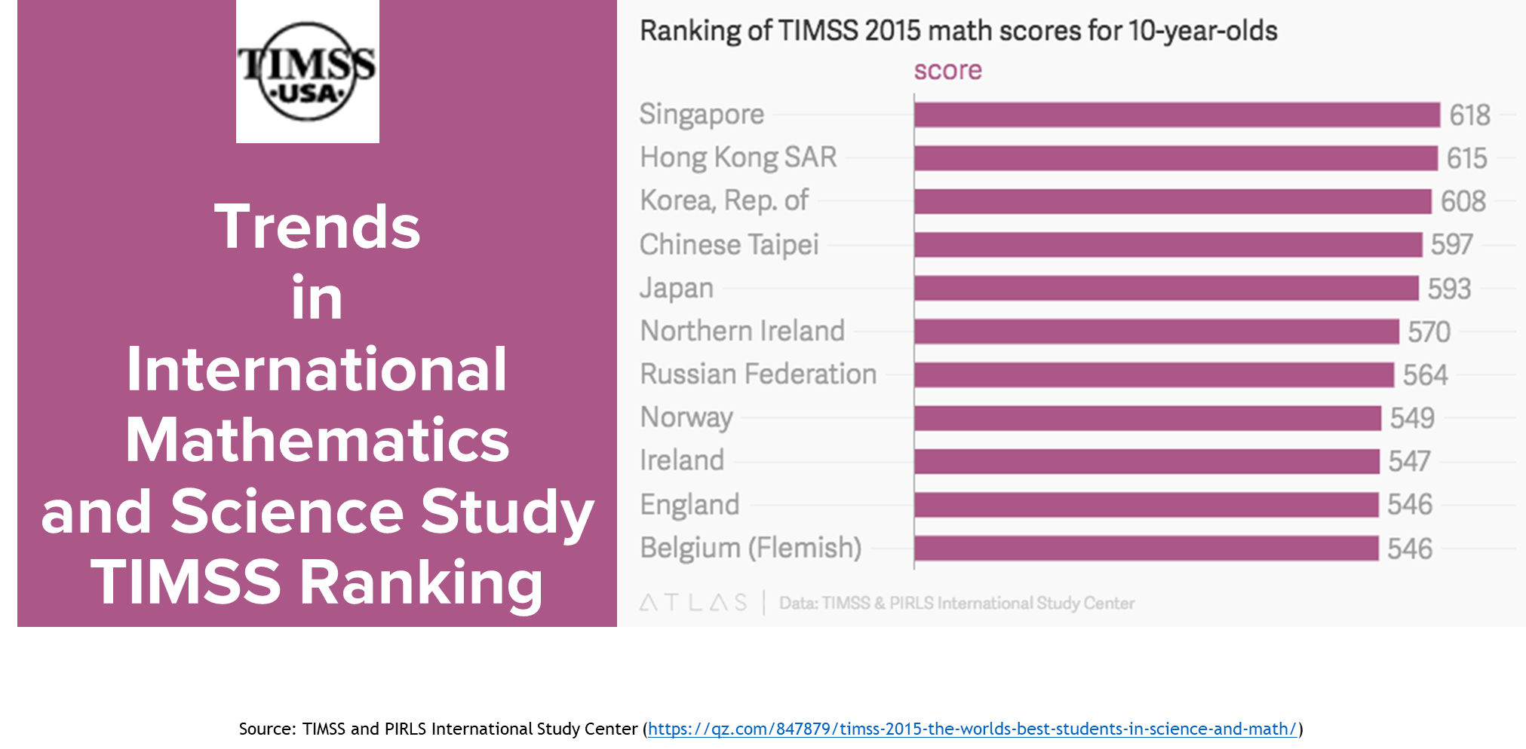

Slide 15
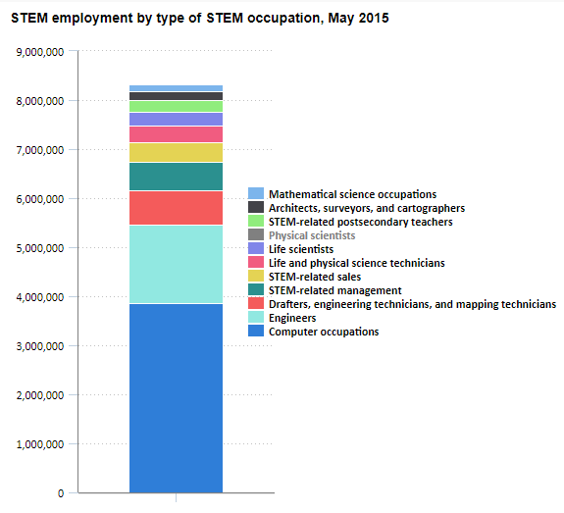

STEM Employment in
USA

Slide 16

Investing in STEM Education
>> India, China, Malaysia, and Singapore are ready examples of how investment in STEM has led to overall economic improvements.
>> Investment in STEM education is crucial for future advancement and sustainable economic development of a country
>> The importance of STEM is acknowledged globally. America, for example, has a committee on STEM Education (CoSTEM) to support and fulfil the growing demand of high-tech workers in certain career fields.
>> Australia is increasing its focus on STEM learning as well

Slide 17

Future of
ENTREPRENEURSHIP &
STEM Education

Slide 18
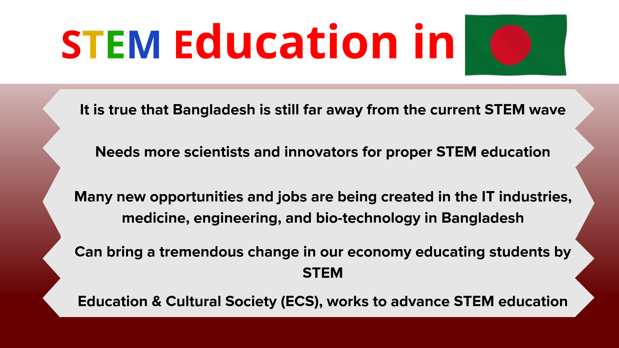

Slide 19
The Way
Forward

Slide 20

Need to increase student
ACHIEVEMENT
in Mathematics and Science and expand STEM education

Slide 21

PUBLIC-PRIVATE PARTNERSHIPS
involving major Companies, Universities, Foundations, Non-profit Organizations, and Government Agencies should be ensured to emphasize STEM education

Slide 22
Increased commitment from businesses and other stakeholders that support STEM education is critical. STEM education creates the PIPELINE of
FUTURE INNOVATORS

Slide 23
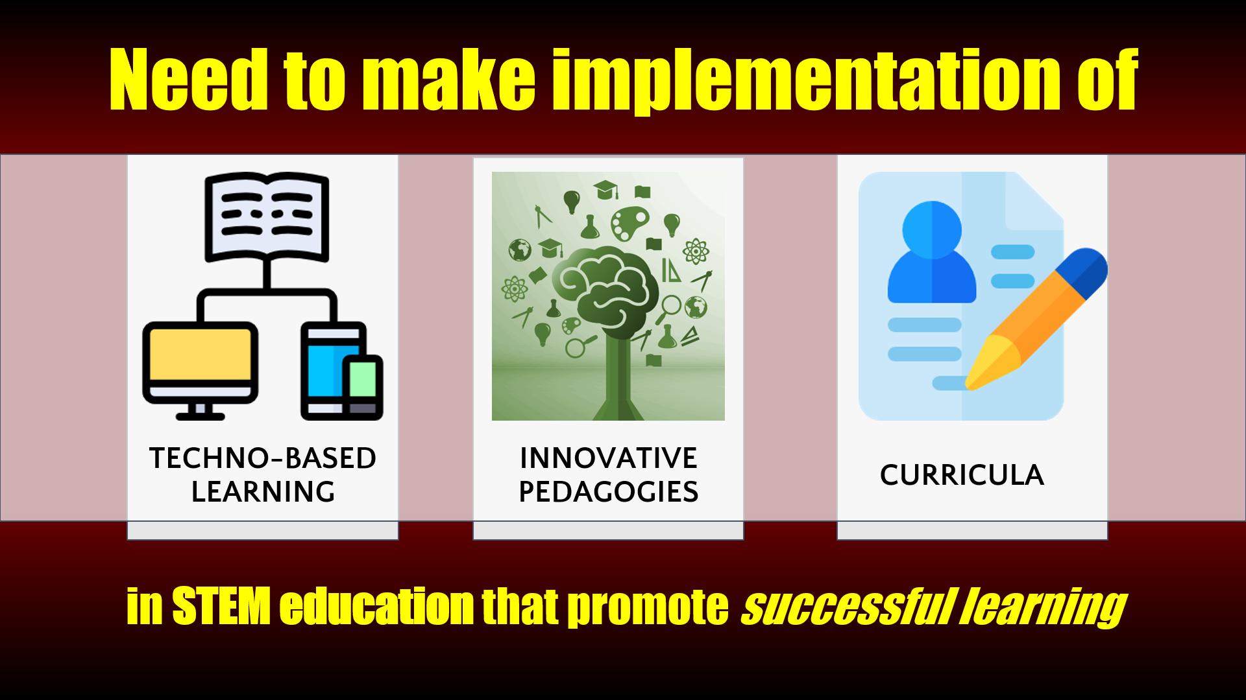

Slide 24


Slide 25


Slide 26
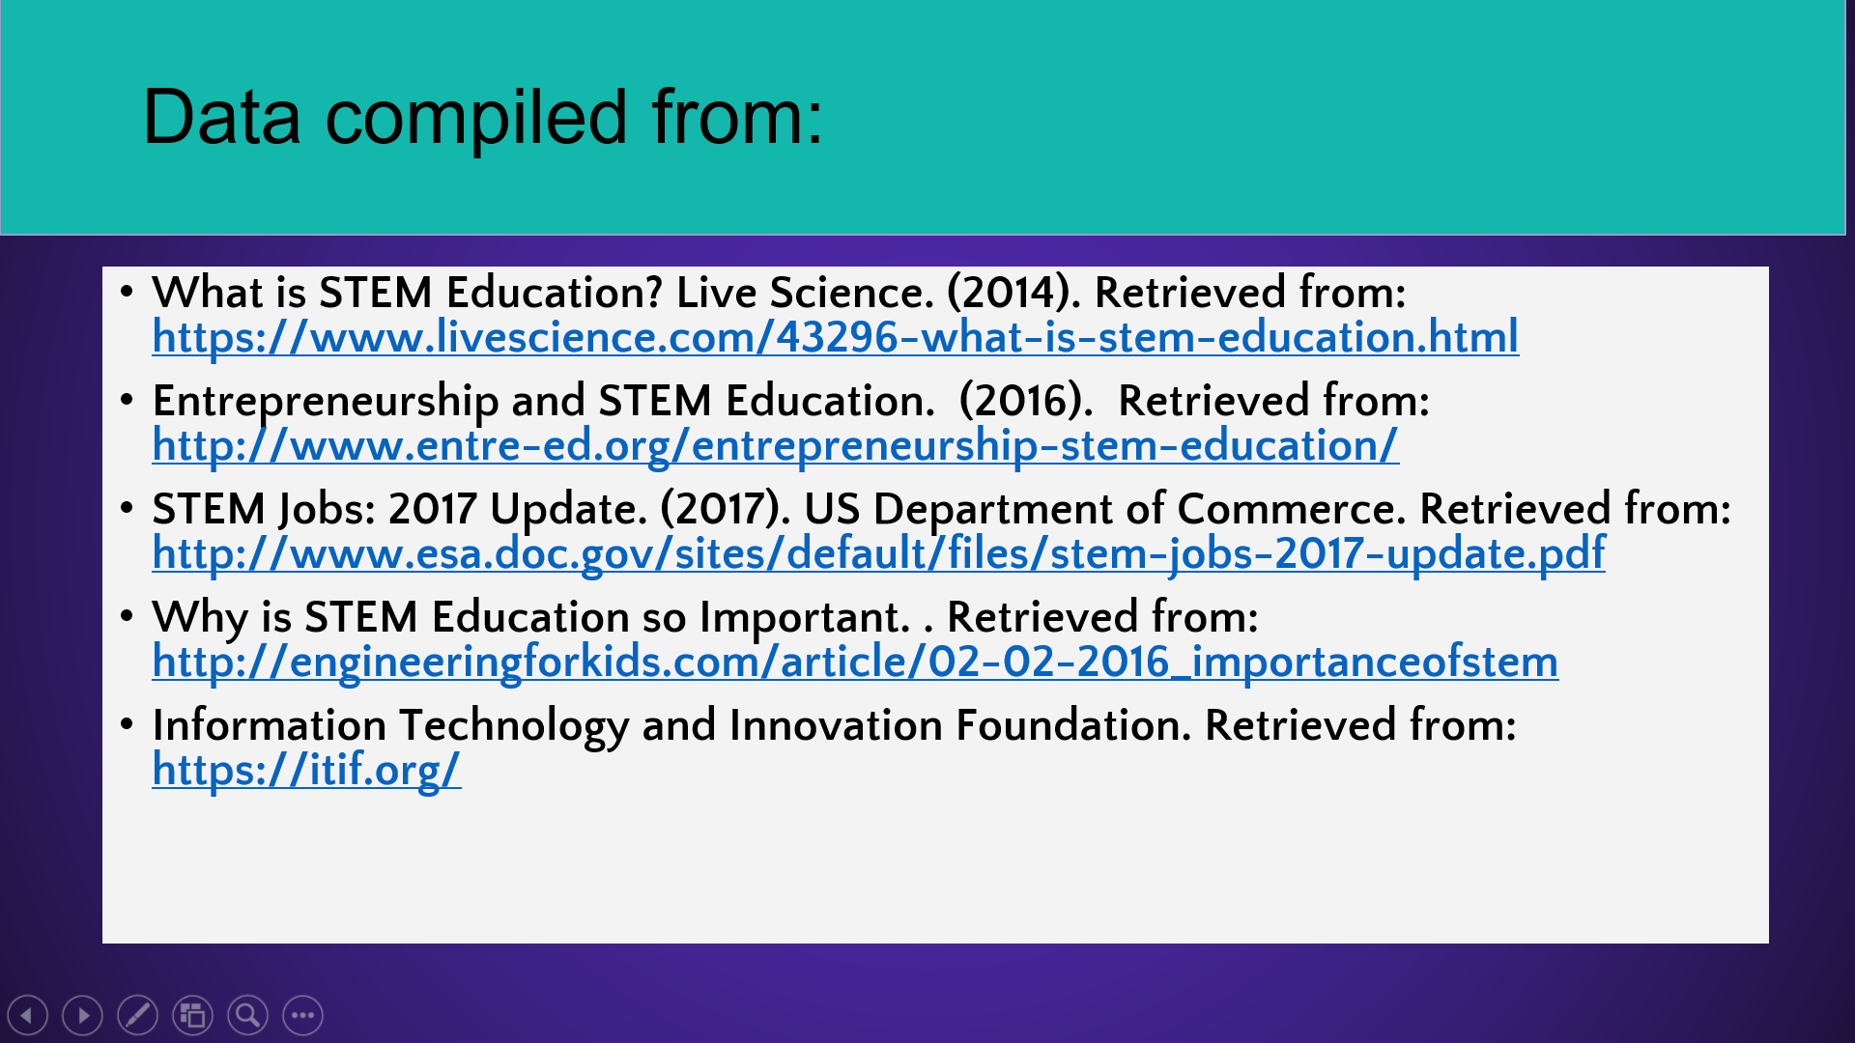

Slide 27


