Slide 1
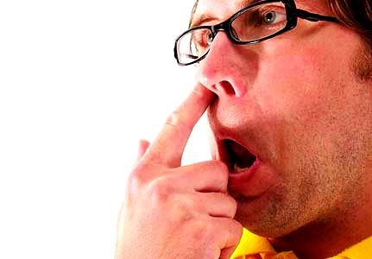
L
Learning to Learn
Lesson 2
Unlearn

Slide 2
Before You Join Class It is Important to come with your whole body and mind

Slide 3
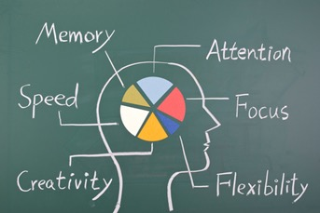

Slide 4
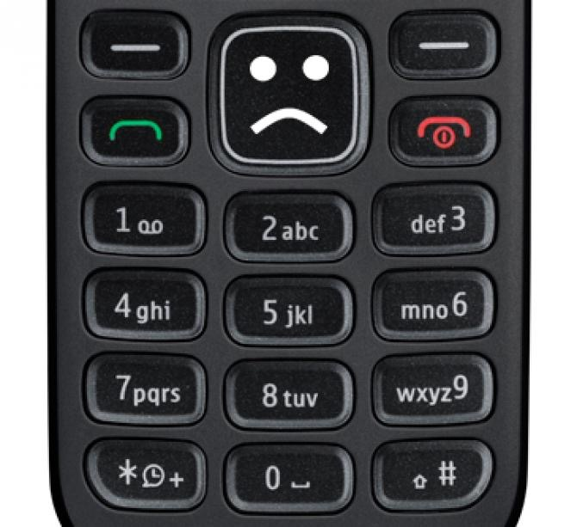
How do we become expert in typing this complex keypad !
Practice never makes human perfect
BUT
Practice with interest makes human perfect

Slide 5
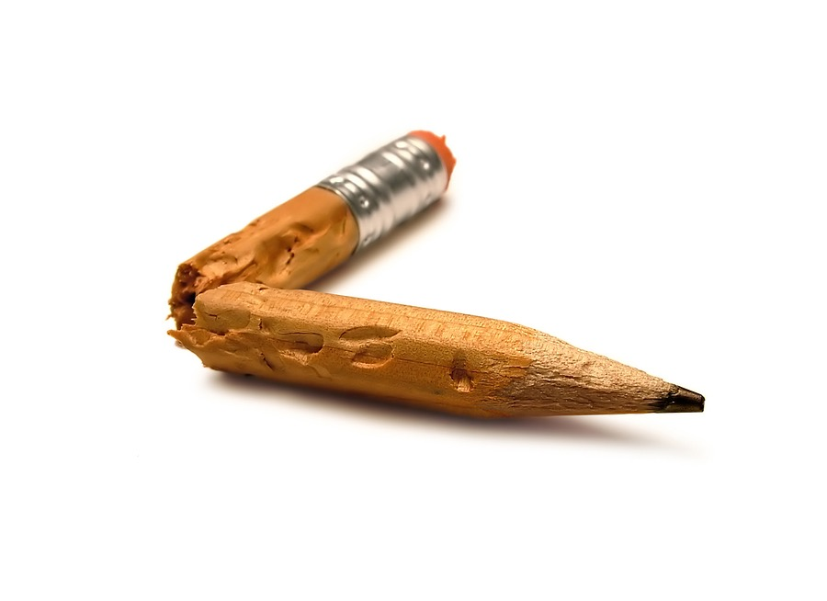
Unlearn

Slide 6
Unlearn

Slide 7
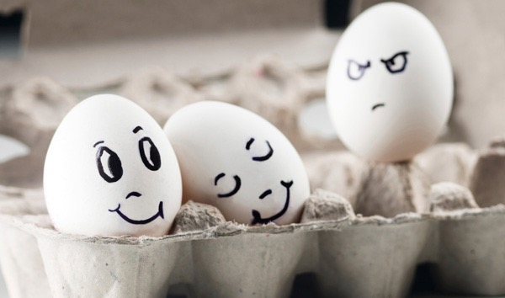
Jealousy hurts
Unlearn
hi

Slide 8
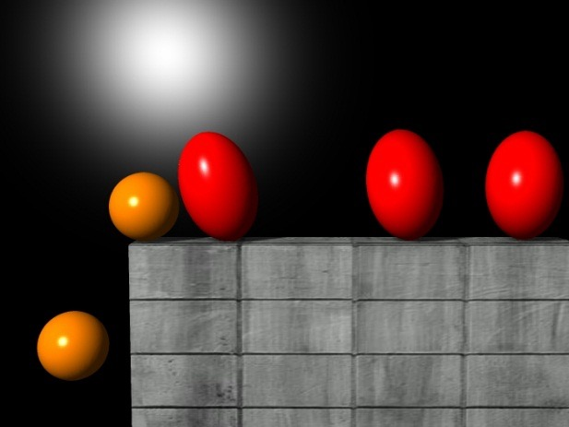
Unlearn
Grouping and misuse of power

Slide 9
Learn to Say Sorry?
Play the video
https://www.facebook.com/ambarin.behbahani/videos/10212501754812066/

Slide 10
-Unlearn
+Learn ++Re-lear

Slide 11
Commit to Life Long Learning
Learn from every step of your life

