Slide 1
TAKEAWAY!
Dr. Md. Sabur Khan, Chairman, BoT,
Daffodil International University

Slide 2
Your
Takeaways from this
Mega Event?

Slide 3
http://gg.gg/ICTCarnival2018
Submit your feedback/ suggestions
for the
NEXT ICT Carnival

Slide 4
FINDINGS?

Slide 5
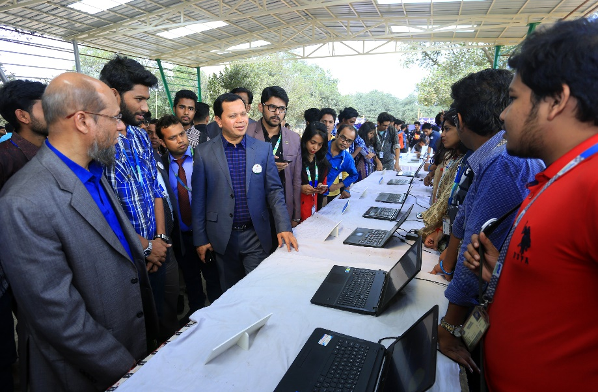
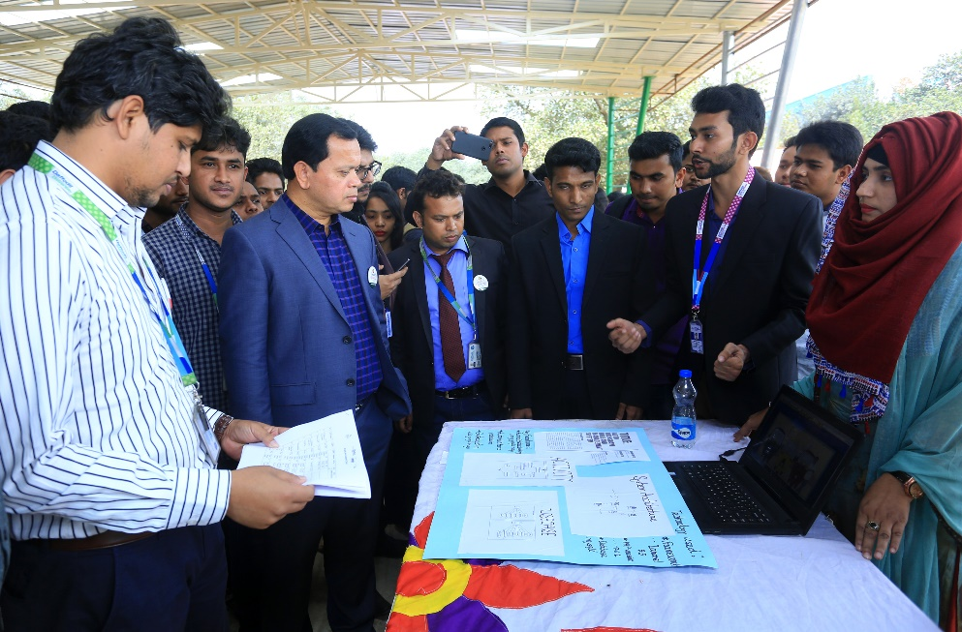
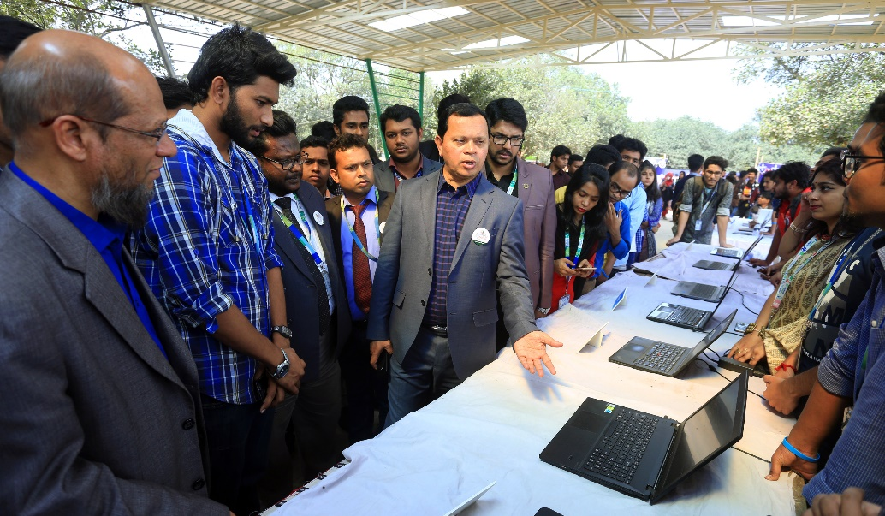
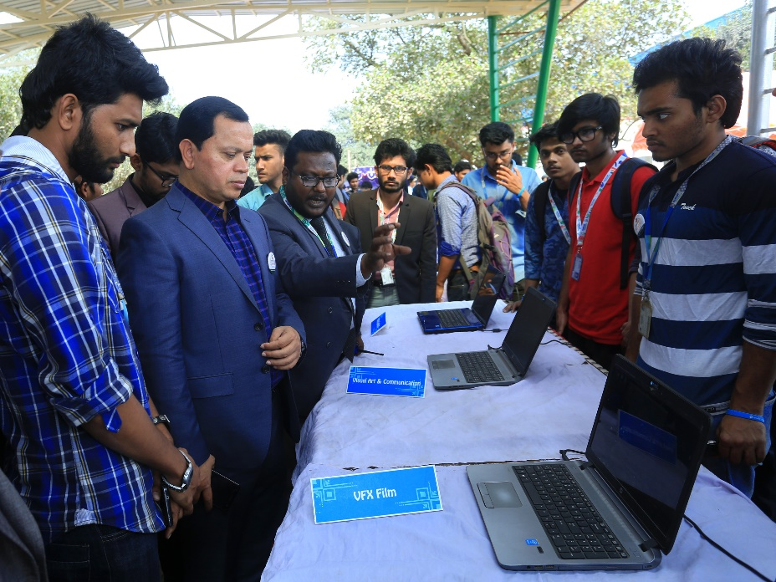
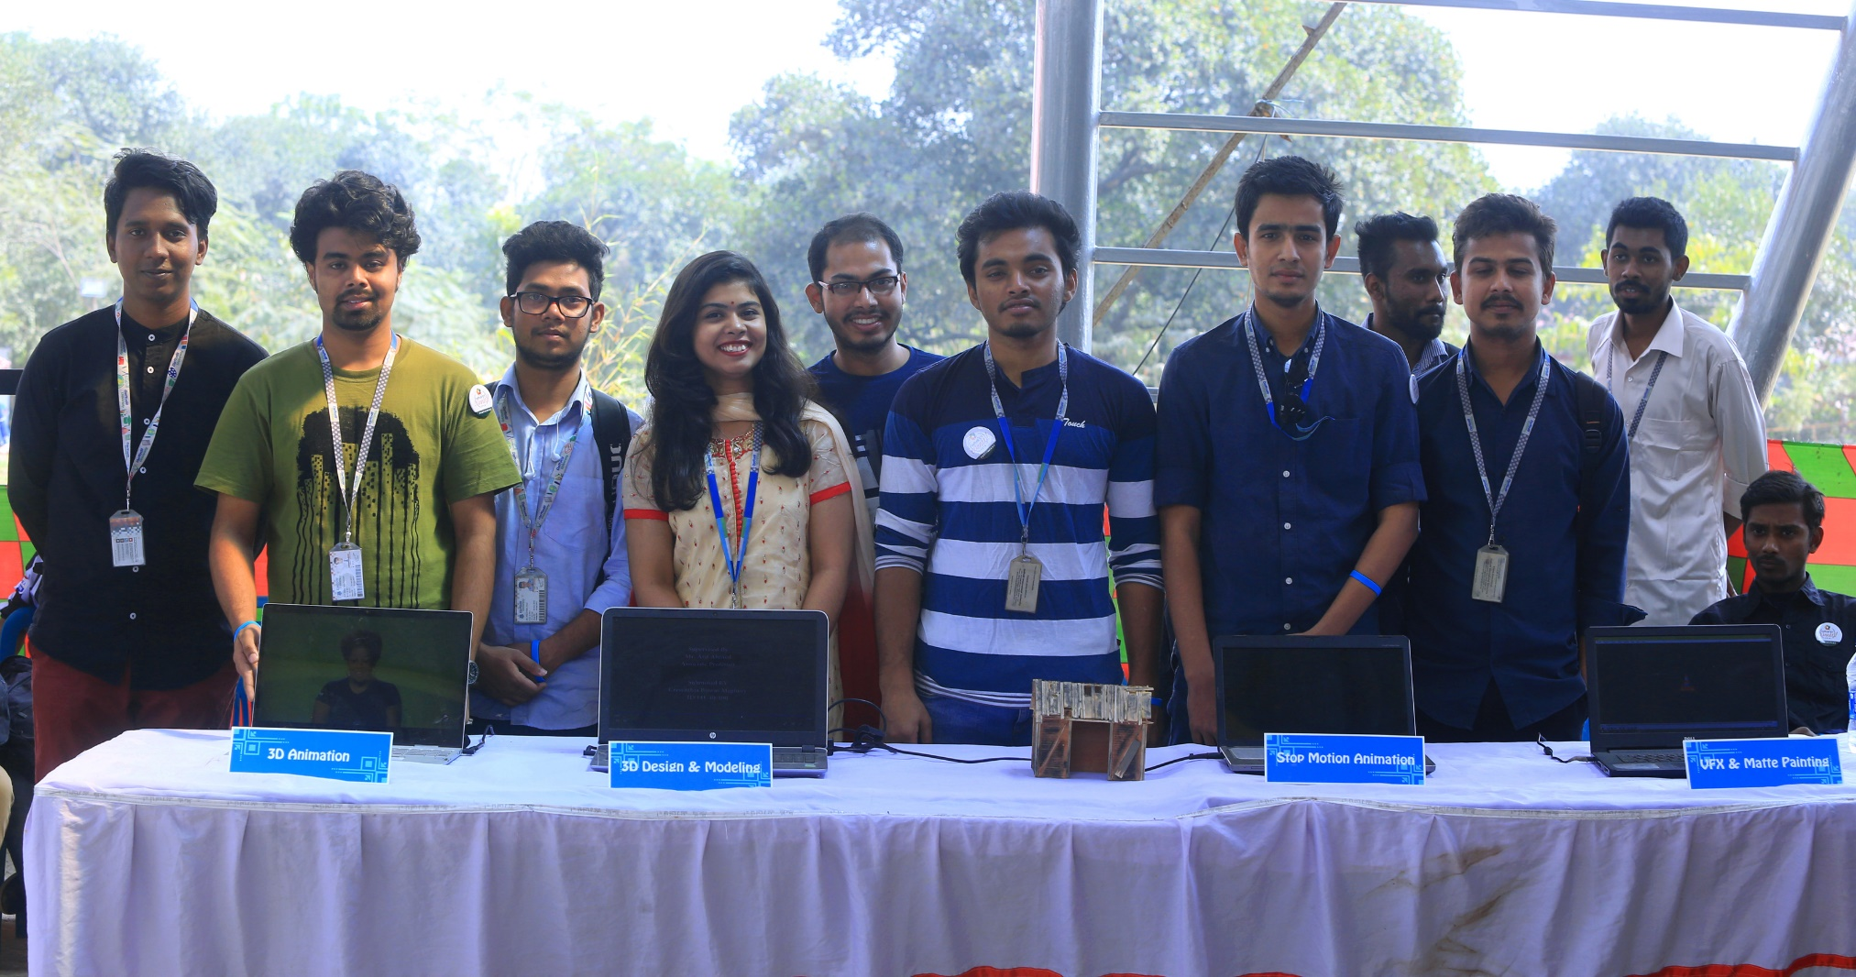
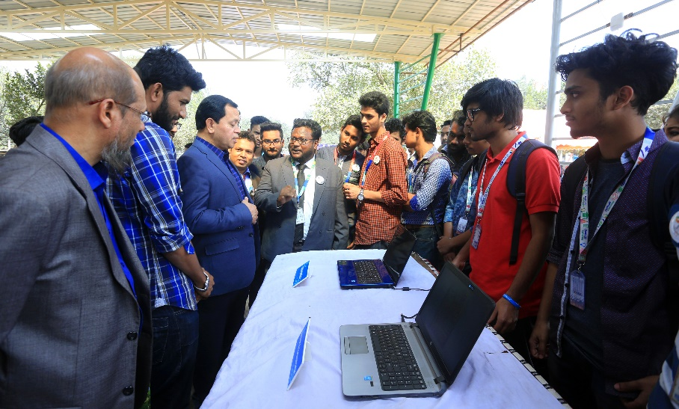
Check Projects
VIABILITY

Slide 6
Nobody has chosen a Company/Specific Target to implement their PROJECTS

Slide 7
Collaborative
Project

Slide 8
HEALTH
Project
Medilab
Desilab
Doctor Finder
Maa
Personal Health Record & Management
Hepatitis Test

Slide 9
Transport
Project

Slide 10
EDUCATION
Apps

Slide 11
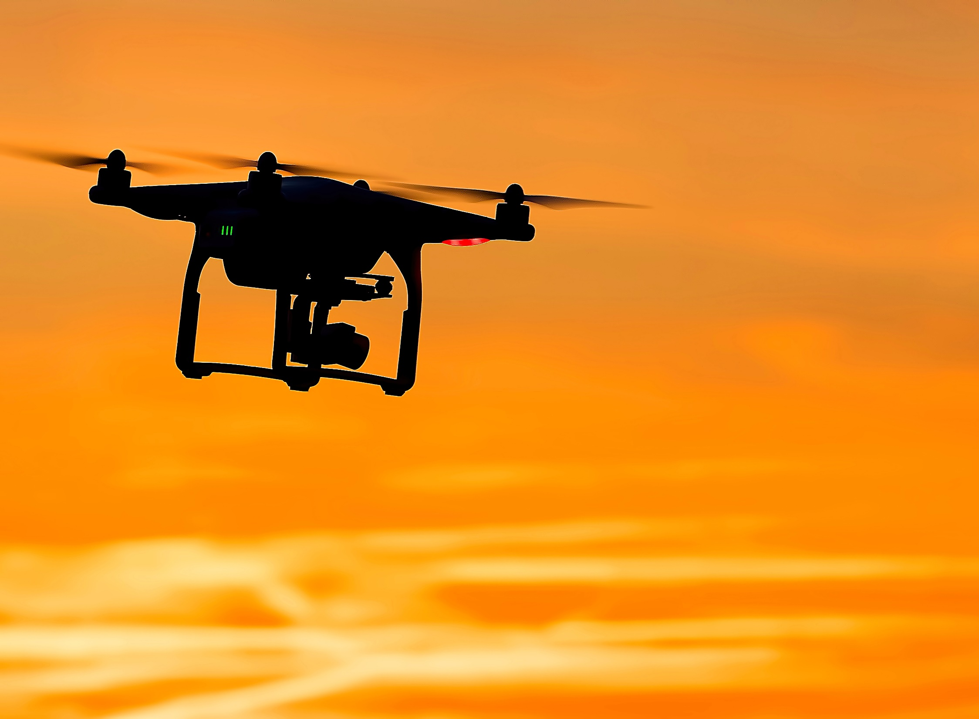
Drone
Project
Identify the
specific
“SECTOR”

Slide 12
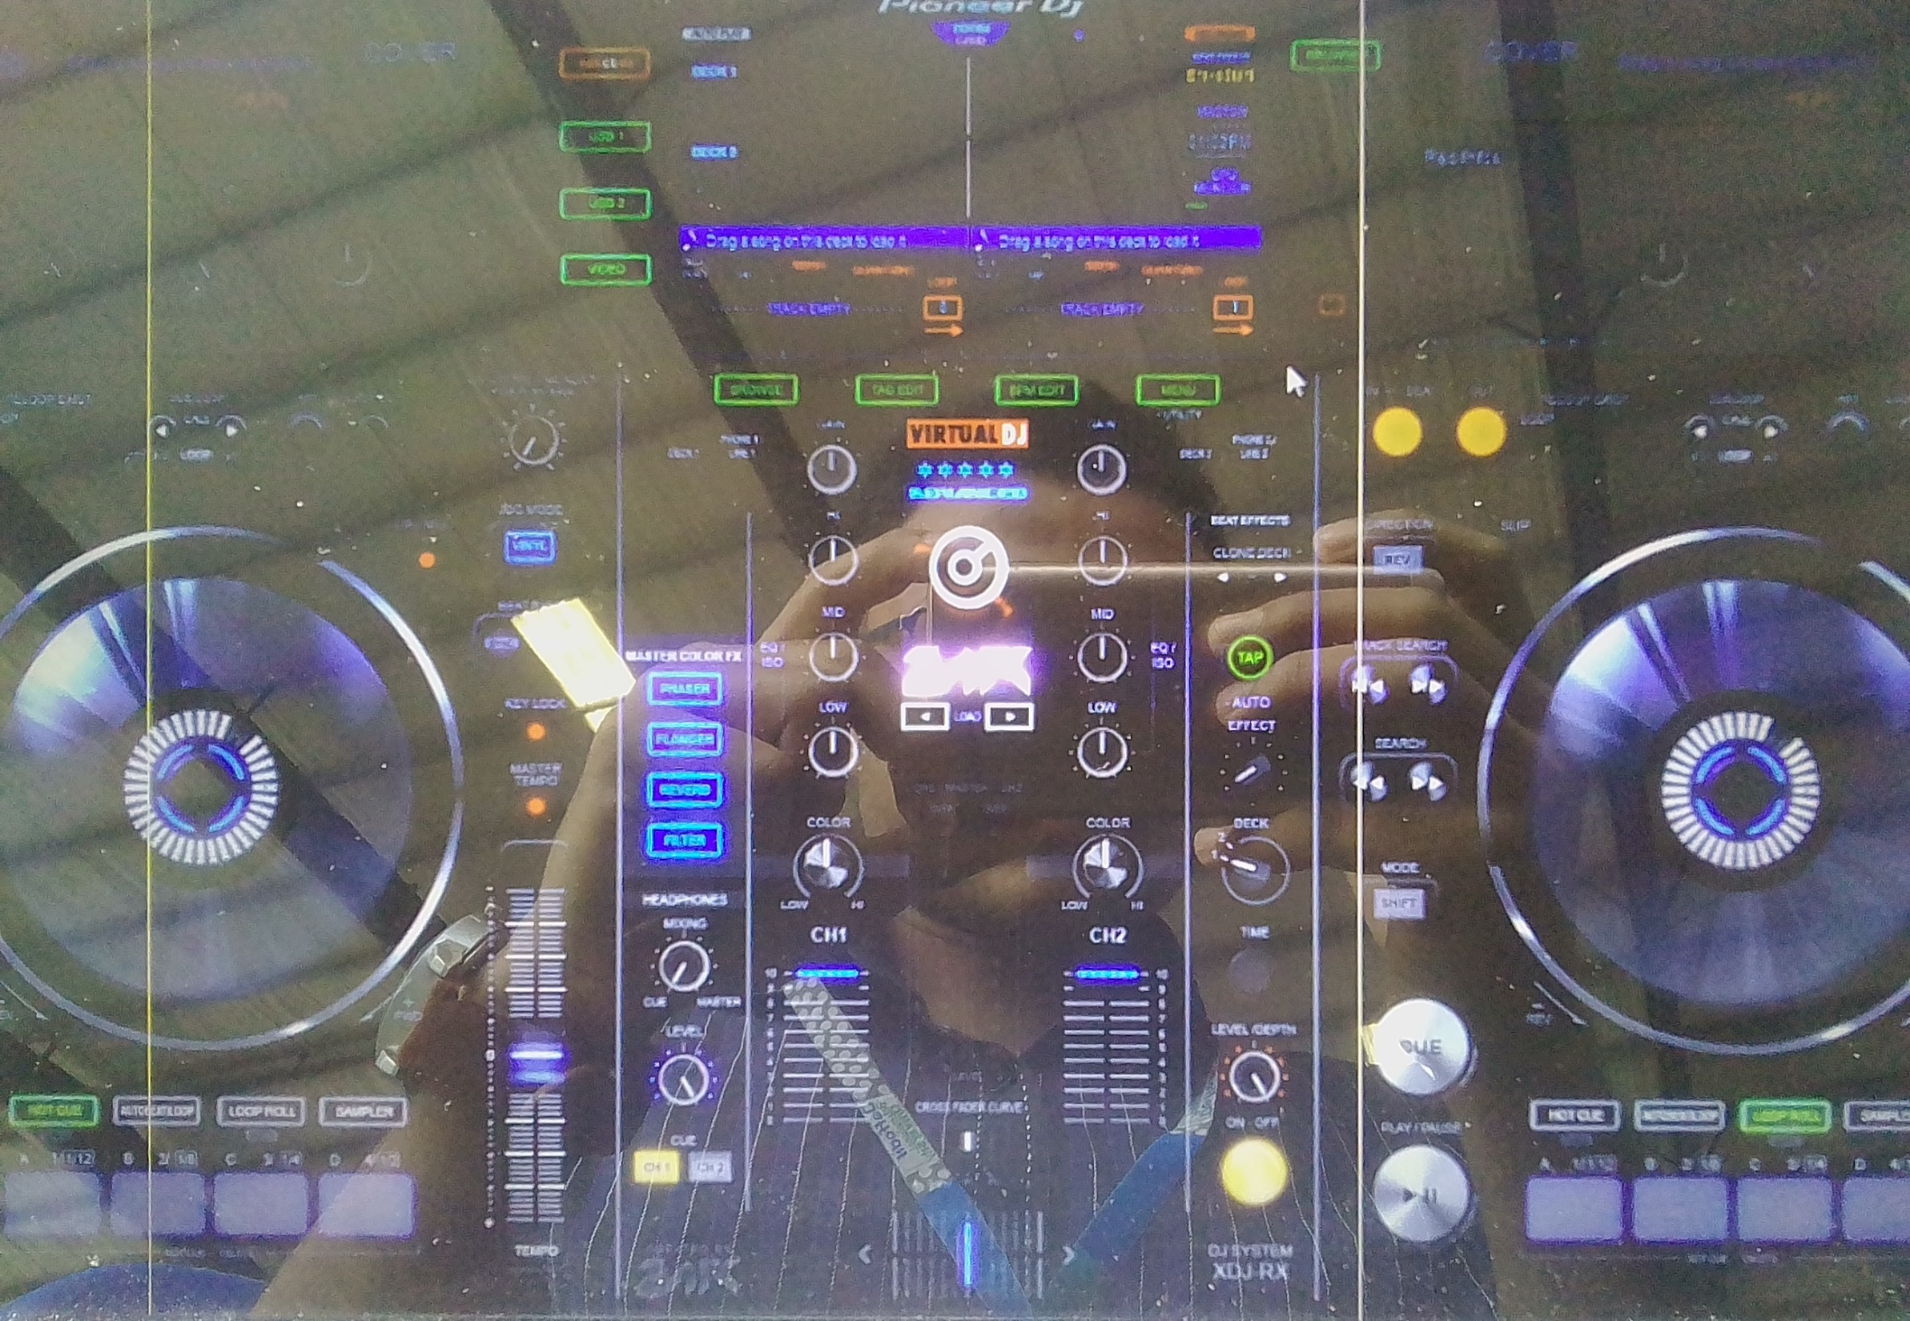

Slide 13
Complete
Product
Will give YOU
Degree

Slide 14
THANK YOU!

